Slide 1
SCADA Home Automation
By
Jonathan Beason, Ben Curths, Simone Gbouomou
Ben McAnulty, Chad Bryan, Ben Calvert
CPE 495 Computer Engineering Design I
CPE 488 Cybersecurity Engineering Capstone I
Electrical and Computer Engineering
The University of Alabama in Huntsville

Slide 2
Table of Contents
Meet The Team 3
Project Summary 4
Reason For Project 5
Marketing Requirements 6-7
Project Model 8
System Design Description 9
Project Update 10
Testing 11
Management Plan/Timeline 12-16
PERT Chart 17
Responsibility 18
Safety Analysis 19
Cost Analysis 1 & 2 20-21
Q & A 22

Slide 3
Meet The Team
Ben Calvert
Jon Beason
Simone Gbouomou
Ben McAnulty
Cybersecurity Engineering
Computer Engineering
Ben Curths
Chad Bryan

Slide 4
Project Summary
The SCADA Home Automation System is a physical and interactive education model designed to emulate today’s smart home systems. The purpose of the project is to introduce and generate interest in cybersecurity among students and young professionals through the use of an interactive model. By creating an interactive model, the students and young professionals will be able to see the effects of cyber-attacks manifest in a physical manner. To accomplish the project objectives, a solenoid, stepper motor, and sensors will be integrated using Arduino microcontrollers running OpenPLC. In addition, a Human Machine Interface (HMI) will be used to control and monitor the SCADA Home Automation System. Students and young professionals will have the opportunity to interact with the system through physical interactions with the model and by performing cyber-attacks on the system.

Slide 5
Reason For Project
Create an interactive model that can be used for educational purposes.
Generate interest in Cybersecurity/Computer Engineering amongst students and young professionals.
Reduce the shortage of Cybersecurity/Computer Engineering professionals.
Demonstrate why Cybersecurity/Computer Engineering is important.
Promote UAH by highlighting skills/knowledge gained through attending UAH’s College of Engineering.

Slide 6
Marketing Requirements 1
Flashy:
Multiple changing lights, makes sounds including alarms or buzzer, and looks visually interesting.
Interactive:
Moveable components with reactive feedback.
Portable:
Lightweight, Ergonomic, Easy to set up, and Simple to use

Slide 7
Marketing Requirements 2
Technical:
SCADA system built using OpenPLC, Modbus and Ladder Logic. Monitor the system using an Human Machine Interface (HMI).
Hacks:
Hollywood style movie hacks, Physically/Visually changes the state of the product. Non-technical style hacks that are easy to understand/implement.
Patchable:
Easy to patch or mitigate the vulnerability of the SCADA system.

Slide 8
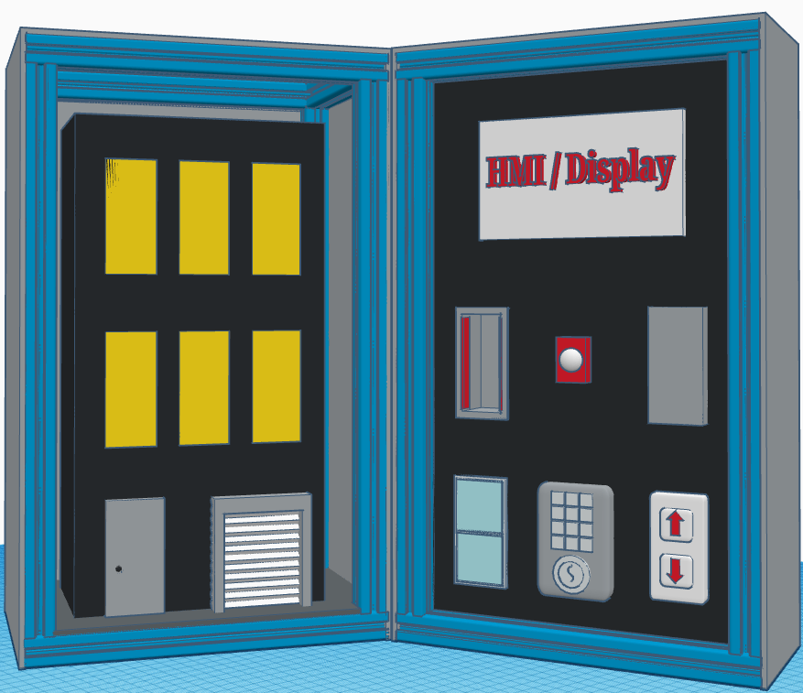
SCADA Home Automation Model
SCADA Home Automation Model(Smart Home control panel)
Components
Left Panel
Right Panel
Model Home
Smart Lock Mechanism
Working garage door
Smart Lock Control
Garage Door Control
Window Control
Infrared Sensor
Motion Sensor

Slide 9
System Design Description
The deliverable will be a portable case that contains a model home with multiple physical security controls commonly found in modern households.
These security controls will send their current states to a HMI displayed in the case.
During a demonstration of our device, cyber attacks will be conducted which allow unauthorized access to the model home.
These attacks will be conducted from an external computer connected through a network hub attached to the case.

Slide 10
Project Update
Completed Tasks
Project requirement & specification defined.
Selected components & determined layout.
OpenPlc install on Raspberry Pi 4.
Preliminary scaled model constructed.
Phase II Goals
Acquire materials & components
Construct case & model
Integrate components
Program system using Ladder Logic
Perform general testing
Cybersecurity analysis
Develop hacks
Acceptance tests

Slide 11
Testing Plan
Unit Testing: the functionality of the individual system components will be tested during the development of the Ladder Logic.
Integration Testing: after the system components are integrated into the model the components will be tested to ensure they work.
Regression Testing: if the system is altered by modification or the integration on new components the system will be retested.
Acceptance Testing: upon completion of the project the system as a whole will be tested to ensure it functions per the stakeholders request.

Slide 12
Project Management Plan
Scrum-Based Agile Framework:
Modified Scrum-based plan consisting of 2-week-long sprints for maximum flexibility.
Regular Meetings:
Sprint kickoff and retrospective meetings for each sprint. Project sponsors/mentors are encouraged to attend to provide feedback, but this is not required. Additional mid-sprint meeting for communication and progress updates. Unscheduled irregular meetings will also occur as needed.
Peer Review and Accountability:
Anonymous peer review surveys collected after every two sprints. Contributions may be reviewed and project sponsor/mentor feedback may be collected.

Slide 13
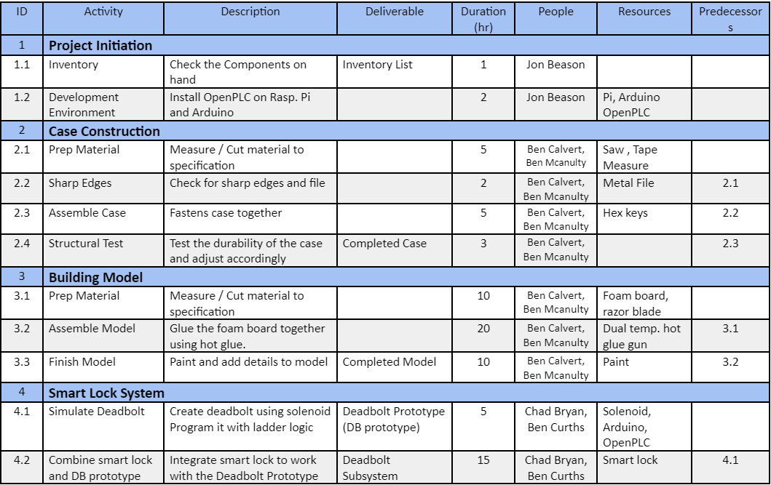
Timeline (1)

Slide 14
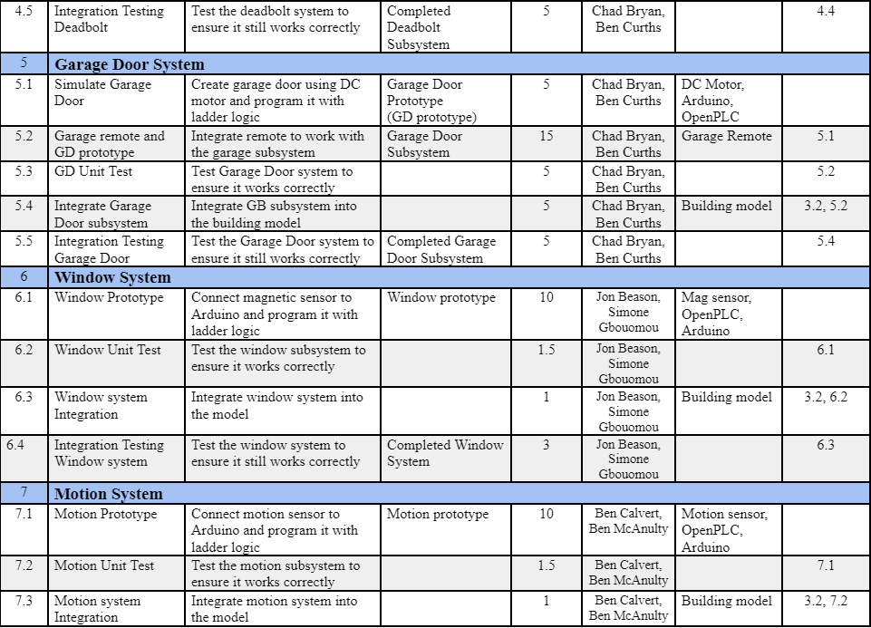
Timeline (2)

Slide 15
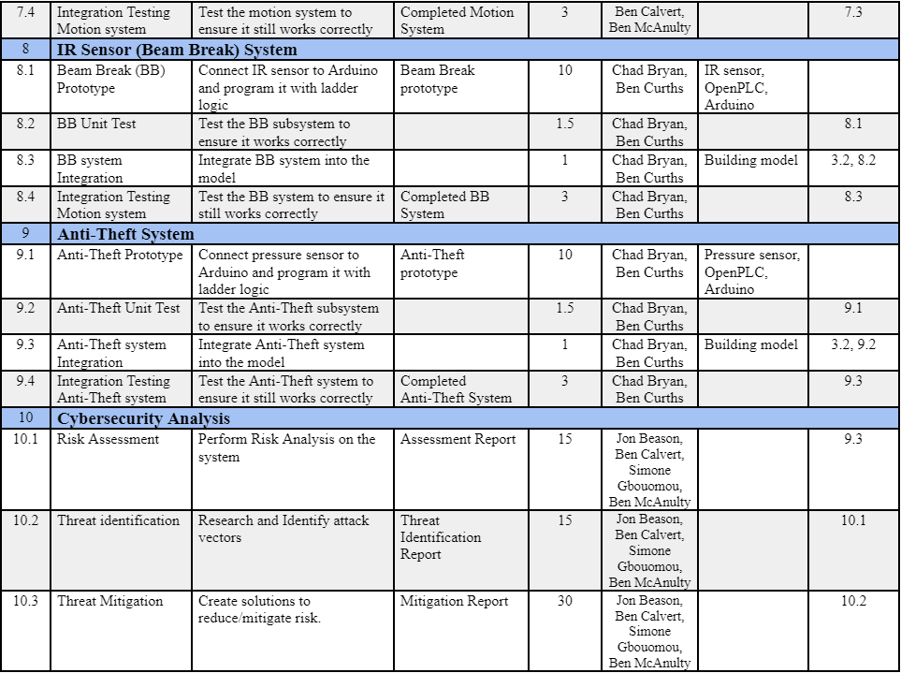
Timeline (3)

Slide 16
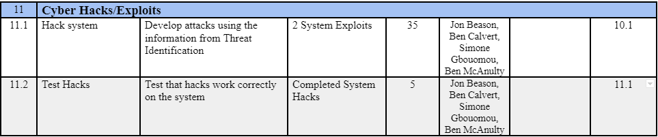
Timeline (4)

Slide 17
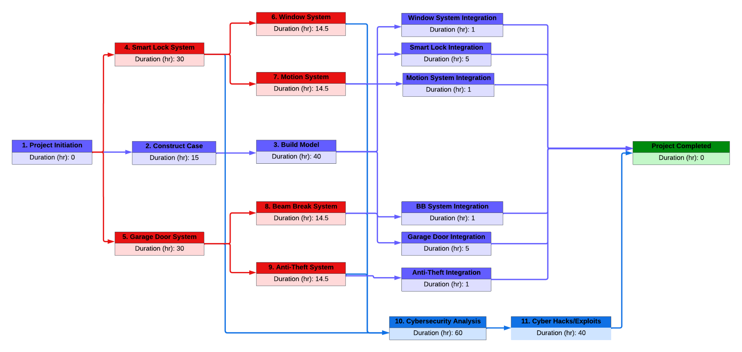
PERT Chart

Slide 18
Division of Responsibility
Ben Calvert
Case/model Construction, Motion System, Cybersecurity Analysis, Cyber Hacks/Exploits
Ben Mcanulty
Model Construction, Motion System, Cybersecurity Analysis, Cyber Hacks/Exploits
Jonathan Beason
Project Initiation, Window System, Cybersecurity Analysis, Cyber Hacks/Exploits
Simone Gbouomou
Model construction, Motion system, cybersecurity analysis, cyber Hack/Exploits
Ben Curths
Smart Lock System, Garage Door System, IR Sensor System, Anti-Theft System
Chad Bryan
Smart lock system, garage door system, IR system sensor, Anti-theft system

Slide 19
Safety Analysis
Soldering Iron Burns
Mitigation - designate a hot zone for soldering and label with warning signs.
Toxic fumes from Solder Iron
Mitigation - use lead-free soldering wire and solder in well ventilated areas.
Electrical shock from prototyping
Mitigation - disconnect power when modifying / connecting components.
Sharp edges / tools during case construction
Mitigation - wear PPE file sharp edges. Unplug tools when not in use.
Construction Phase

Slide 20
Cost Analysis 1
Funding provided by the ECE Department: $400
Estimated labor cost in hours: 287 hours
Itemized price and expenses: $407
Fixed Cost: None
Variable Cost: Labor/Materials
A break down of all cost associated with the project can be seen on Cost Analysis 2

Slide 21
Cost Analysis 2
Components / Hardware
Software / Services
2 Raspberry Pi 4 $90
1 Arduino Mega $50
1 Monitor $70
2 3mm IR Sensors $6
2 PIR Motion Sensor $20
2 Magnetic Sensor $8
1 Force-Sensitive Sensor $6
1 Small Solenoid $8
2 Micro Limit Switch 10pc $7
1 DC Motor $13
1 10pc 1000mm Alum. Extrus $80
1 Smart Deadbolt $40
1 5 Port Ethernet Hub $10
Subtotal $407
OpenPLC Software Free
scadaBr/ Home - Assistant Free
Linux OS Free
Labor Cost
Building Model 40 hours
Building Case 15 hours
Ladder Logic Programming 60 hours
Circuit Prototyping 20 hours
Integration 14 hours
Testing 38 hours
Cybersecurity Analysis 60 hours
Cybersecurity Hacks 40 hours
Total 287 hours

Slide 22
Project Q/A

